Slide 1

Comprehensive Digital Marketing Project Work
Company : MTR Foods

Slide 2
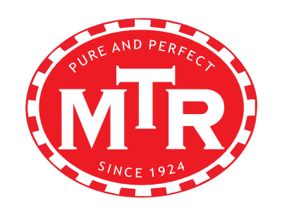
Brand logo :

Slide 3
Part 1: Brand study, Competitor Analysis & Buyer’s/Audience’s Persona
Research Brand Identity: Study the brand's mission, values, vision, and unique selling propositions (USPs).
MISSION : Enhance customer’s quality of life and anticipate their needs. Actively engage in communities we served. Provide sustainable returns to investors. Foster a company culture that staff can learn grow and take pride in.
VISSION : We aim to be a globally recognized leader that connects and grows communities with caring service. Set ourselves new standards through innovation and continuous improvement.
VALUES :
EXCELLENT SERVICE : We are committed to proactively provide safe, efficient caring service valued by customers.
MUTUAL RESPECT : We work in an open team environment based on trust, joint commitment and respect.

Slide 4
Part 1: Brand study, Competitor Analysis & Buyer’s/Audience’s Persona
Usp(Unique proposition selling): The USP of MTR is their quality of product and they provide value for the customers in the process of revenue to the company.
Analyse Brand Messaging: Rich in Legacy.
Examine The Brand’s Tagline: Pure and perfect since 1924

Slide 5
Part 1: Brand study, Competitor Analysis & Buyer’s/Audience’s Persona
Competitor Analysis: Select three competitors operating in the same industry or niche as the chosen brand , examine their USPs and online communication.
Competitor 1: Id Fresh Foods is the biggest rival of MTR Foods Pvt Ltd . Id Foods was founded in 2006 and its headquarters is in Bengaluru, Karnataka. Id Foods operates in the industry.
Competitor 2: Kohinoor Foods has been one of MTR Foods Pvt Ltd’s top competitors. Foods is a private company that was founded in Edison, New jersey in 1976.
Competitor 3: Gits is MTR Foods Pvt Ltd’s #3 rival. Gits was founded in 1963 in Mumbai, Maharashtra. Gits is in the industry.

Slide 6
Part 1: Brand study, Competitor Analysis & Buyer’s/Audience’s PERSONA
Buyer’s/Audience’s Personal info : MTR Foods is a trusted name with a 90 year heritage that serves authentic Indian vegeterian cuisine that brings joy to every household.
Demographics: MTR Foods a company with a hoary legacy is almost certainity not the first brand you would associate with Millennials.
Geographics: MTR Foods global headquarters located in Bengaluru ,Karnataka , India . MTR outlets in the USA,CANADA,UK,GERMANY,AUSTRALIA,NEW ZEALAND, MIDDLE EAST, JAPAN, AND SOUTH EAST ASIAN COUNTRIES.
Psychographics: As a ready to eat foods brand MTR was primarily looking at the urban households with both the spouses working or employed bachelors who didn’t have much time to cook.

Slide 7
Part 1: Brand study, Competitor Analysis & Buyer’s/Audience’s PERSONA
Behaviours: hThe satisfaction level of consumers towards MTR Foods is good and thus they are willing to recommend the brand of MTR Foods to the family and friends. The MTR Foods provided to meet the consumer expectations from the aspect of taste and nutrition.MTR Foods widely accepeted by the consumers as it is convenience and reasonably priced. MTR Foods may develop and introduce new products in the future with the primise that it does fulfill the consumer’s needs.
Interests: MTR Foods is a top brand food processing company in India. Therefore, Indians are aware of this brand and its products. 91% 00of the respondents from India is aware of this brand . They usually make purchase of MTR Foods products on monthly basis. The most popular product choices are 3 minutes Indian breakfast, soups , rice items, and paneer gravies which are also popular in north Indian region.

Slide 8
Part 2: Search engine optimization & keyword research
Search Engine Optimization: At MTR our objective for your business is to get as many first page rankings and traffic to your website as possible for the keywords we agree on, increasing your traffic significantly to maximize your online conversions
Managed search engine optimization is an important marketing factor involved with every successful website. Organic search results direct more traffic online than any other single source on the Internet. Attaining and maintaining top organic/natural listings means constantly staying on top of the latest trends, and implementing these trends quickly and efficiently. In addition there are several additional factors involved in marketing your business online successfully.

Slide 9
Part 2: Search engine optimization & keyword research
Our Services May Include:
Extensive key phrase/Keyword research
On-page optimization suggestions
SEO copywriting
Strategic title and tag adjustments
Link Popularity Analysis
Optimized Content Analysis and Recommendations
Customized Link Building (Directory Submissions)
Website Analytics (Google Analytics Installed)

Slide 10
Part 2: Search engine optimization & keyword research
On page Optimization: On-page optimization in the context of Lakmé, a well-known beauty and cosmetics brand, refers to the process of optimizing their website's individual pages to improve their search engine rankings, user experience, and overall visibility on the internet. It involves making strategic changes and improvements to the website's content, structure, and HTML elements to ensure it is relevant and appealing to both search engines and users.
Keyword Research: Conduct thorough keyword research to identify the most relevant and valuable keywords related to MTR Foods products, services, and industry. Use tools like Google Keyword Planner or other SEO keyword research tools to find high-volume, low-competition keywords.

Slide 11
Part 3: CONTENT IDEAS AND MARKETING STRATEGIES
CONTENT IDEAS:MTR Foods has come out with a modern-day twist in their latest marketing campaign. The creative conceptualised by Ogilvy & Mather aims at positioning the breakfast mix as a perfect Sunday special menu. As used in the brand’s previous ad campaign, the creative concept of the six-arm device is retained in the new ad as well, but with a contemporary look.
The old communication showed how all the family members simply gave their varied breakfast preferences to the woman of the household who then proceeded to multi-task and cook up all the dishes. The visual of six hands were shown to impart the idea of being a supernatural being (referring to a goddess). The new ad film, on the other hand is about a family enjoying a breakfast meal on Sunday. The woman here is not making the breakfast alone; she is being helped by her children and husband and that is the reason, the six hands are formed behind the woman. The objective of the new campaign is to communicate how MTR’s wide range of Breakfast Mixes are a great fit for weekend consumption and a natural choice for families to come together both in the kitchen and at the dining table.

Slide 12
Part 3: CONTENT IDEAS AND MARKETING STRATEGIES
Before Mavalli Tiffin Room became MTR Foods, one of the country’s leading processed food makers, it was a small restaurant operating in south Bangalore with a heady stream of faithful customers who swore by its idlis and dosas. Nineteen seventy-six changed everything. MTR, owned by the Maiya family, was forced into the FMCG business of selling instant food mixes by the Emergency. Turbulent times as they were, MTR’s business came to a grinding halt after the government imposed pricing curbs.
Price of the modest idli, for instance, was clipped to 10 paise from 25 paise while a cup of coffee had to be sold at 25 p from Re 1 under President’s rule. Soon there was no stopping the mounting losses. MTR ran up losses of Rs 25, 000 every weekday and up to Rs 1 lakh on Sundays. Sixteen days after it was told to reduce prices, the restaurant was forced to shut shop.

Slide 13
Part 3: CONTENT IDEAS AND MARKETING STRATEGIES
-
-
-
-
-
-As the company has the history of a high standard eatery, all the products are made with premium quality ingredients. The hygienic atmosphere is maintained in case of making the products. The past of having the standardized eatery makes the brand still credible to the public.
-Authenticity is one of the main aspects which are mandatorily maintained in all the products manufactured so far in all the packaged food products made by MTR. So, the main market strategy is to deliver the consumers with the instant food products having the exact aroma and flavor.
-Expansion of the domestic presence of MTR is one of the greatest marketing strategies taken by the brand. Presently there are outlets of the company in most parts of the country.

Slide 14
Part 3: CONTENT IDEAS AND MARKETING STRATEGIES
MTR is one of the most prominent brands which manufacture instant foods under the ownership of Orkla. Apart from it the restaurant business is also present till date. The products make difference among the public due to the quality and price affordability. The above marketing strategies are the most important pillars upon which the company is standing.
The customer base for all the products made by MTR is decent because the items belong to their staple diet. Remarkably, the places where these products are exported mainly have prominent South Indian Communities. One of the main reasons why the company is gaining more importance in the recent years is due to more people gaining interest in South Indian Foods. Quick breakfast techniques are one of the main conveniences for any consumer who does not get much time for making it.

Slide 15
Part 4: Content Creation and Curation (Post creations, Designs/Video Editing, Ad Campaigns over Social Media and Email Ideation and Creation)
Post Creation:
●Select Content Categories: Identify three different content formats relevant to the chosen topic or industry. Research and Brainstorm: Research trending topics, industry news, or audience interests within each category. Brainstorm ideas for social media posts that align with each category. Do note that 1 content format has to be video and additionally 3 stories/status are to be created.
Format 1
Format 2
Format 3

Slide 16
PART 4: CONTENT CREATION AND CURATION (POST CREATIONS, DESIGNS/VIDEO EDITING, AD CAMPAIGNS OVER SOCIAL MEDIA AND EMAIL IDEATION AND CREATION)
FORMAT:1
The company began with the establishment of the Mavalli Tiffin Room (commonly known as MTR) restaurant in Bangalore in 1924 by Yagnanarayana Maiya.
In 1975, when India was under emergency, a Food Control Act was introduced which mandated that food was to be sold at very low prices. This move made it difficult for MTR to maintain high standards in its restaurant business and forced it to diversify into the instant food business by the following year, selling ready-to-eat snacks such as chutneys and rasams.
In 1984, MTR expanded out of Karnataka to the southern states of Tamil Nadu and Andhra Pradesh.

Slide 17
PART 4: CONTENT CREATION AND CURATION (POST CREATIONS, DESIGNS/VIDEO EDITING, AD CAMPAIGNS OVER SOCIAL MEDIA AND EMAIL IDEATION AND CREATION)
Growth and profitability:
The company is currently an approximately ₹1000 crore company ^{[3]} which is growing at a CAGR of 13%. The company has been listed as a Fortune Next 500 (India's Top Midsize) company for 2016.
Business:
In 2011, MTR launched a sub-brand called MTR Snack Up with a range of traditional South Indian snacks like Khara Boondi and Benne Murukku.^{[4]}
In 2017, MTR launched a new brand called Laban.^{[5]}

Slide 18
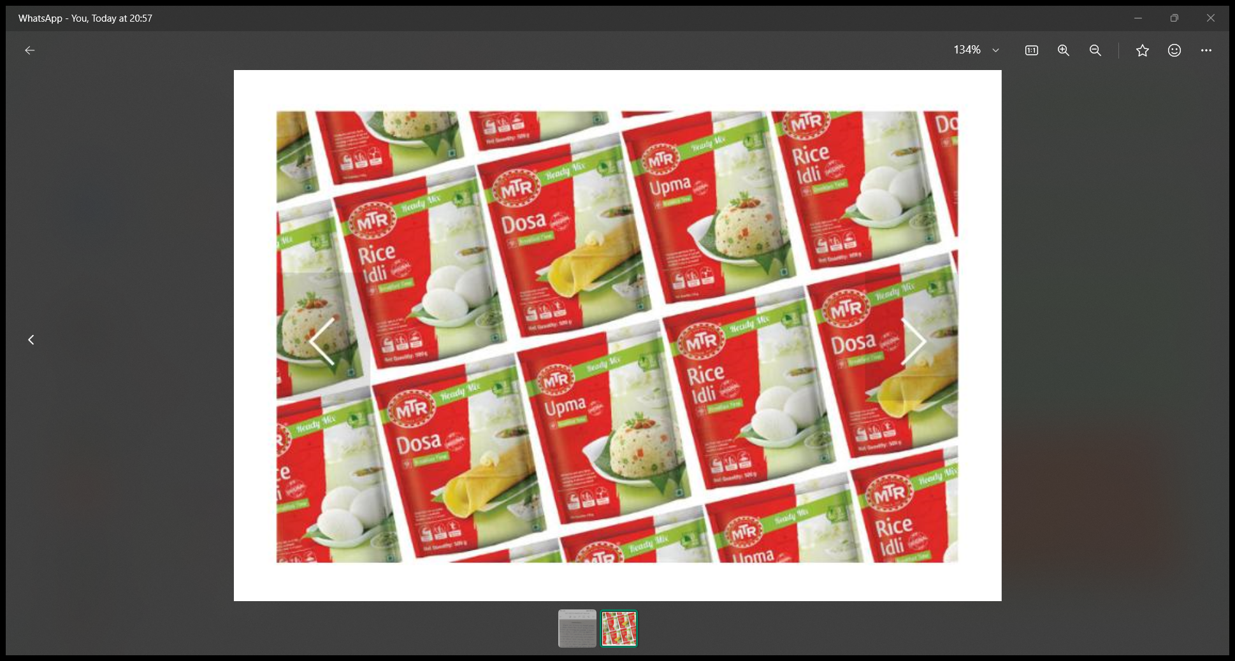
FOMAT 2:

Slide 19
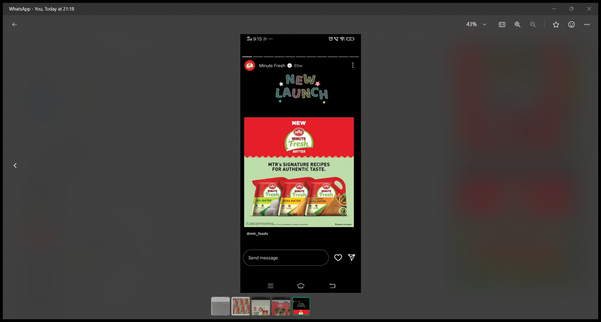
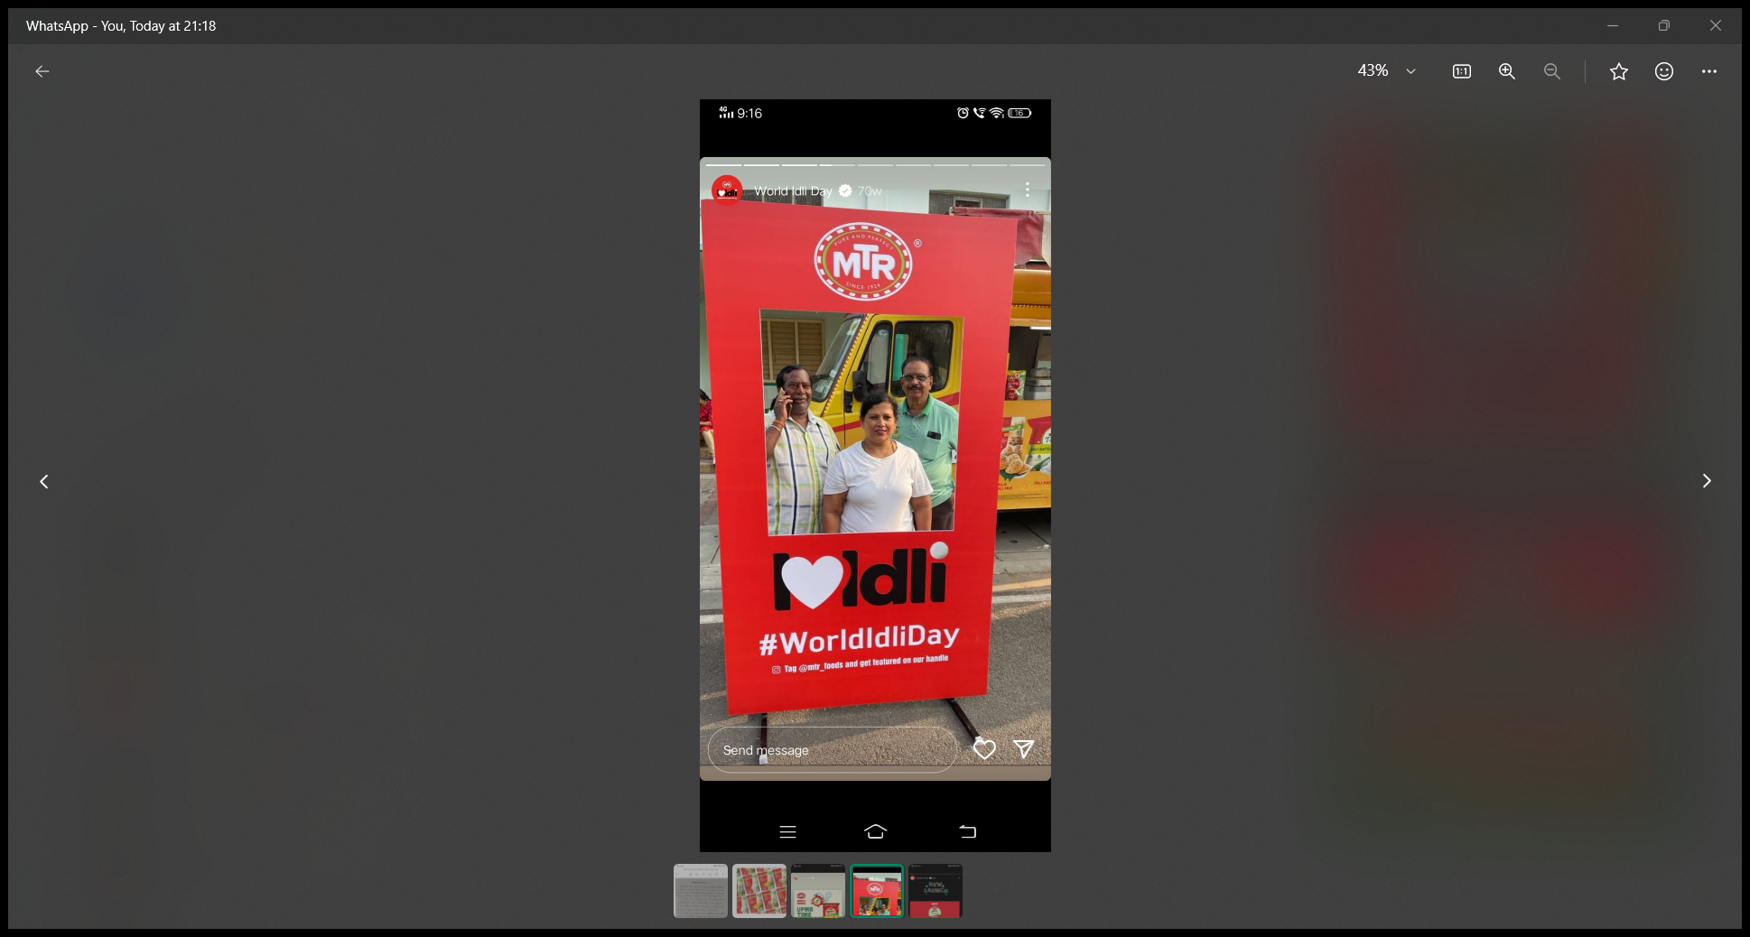
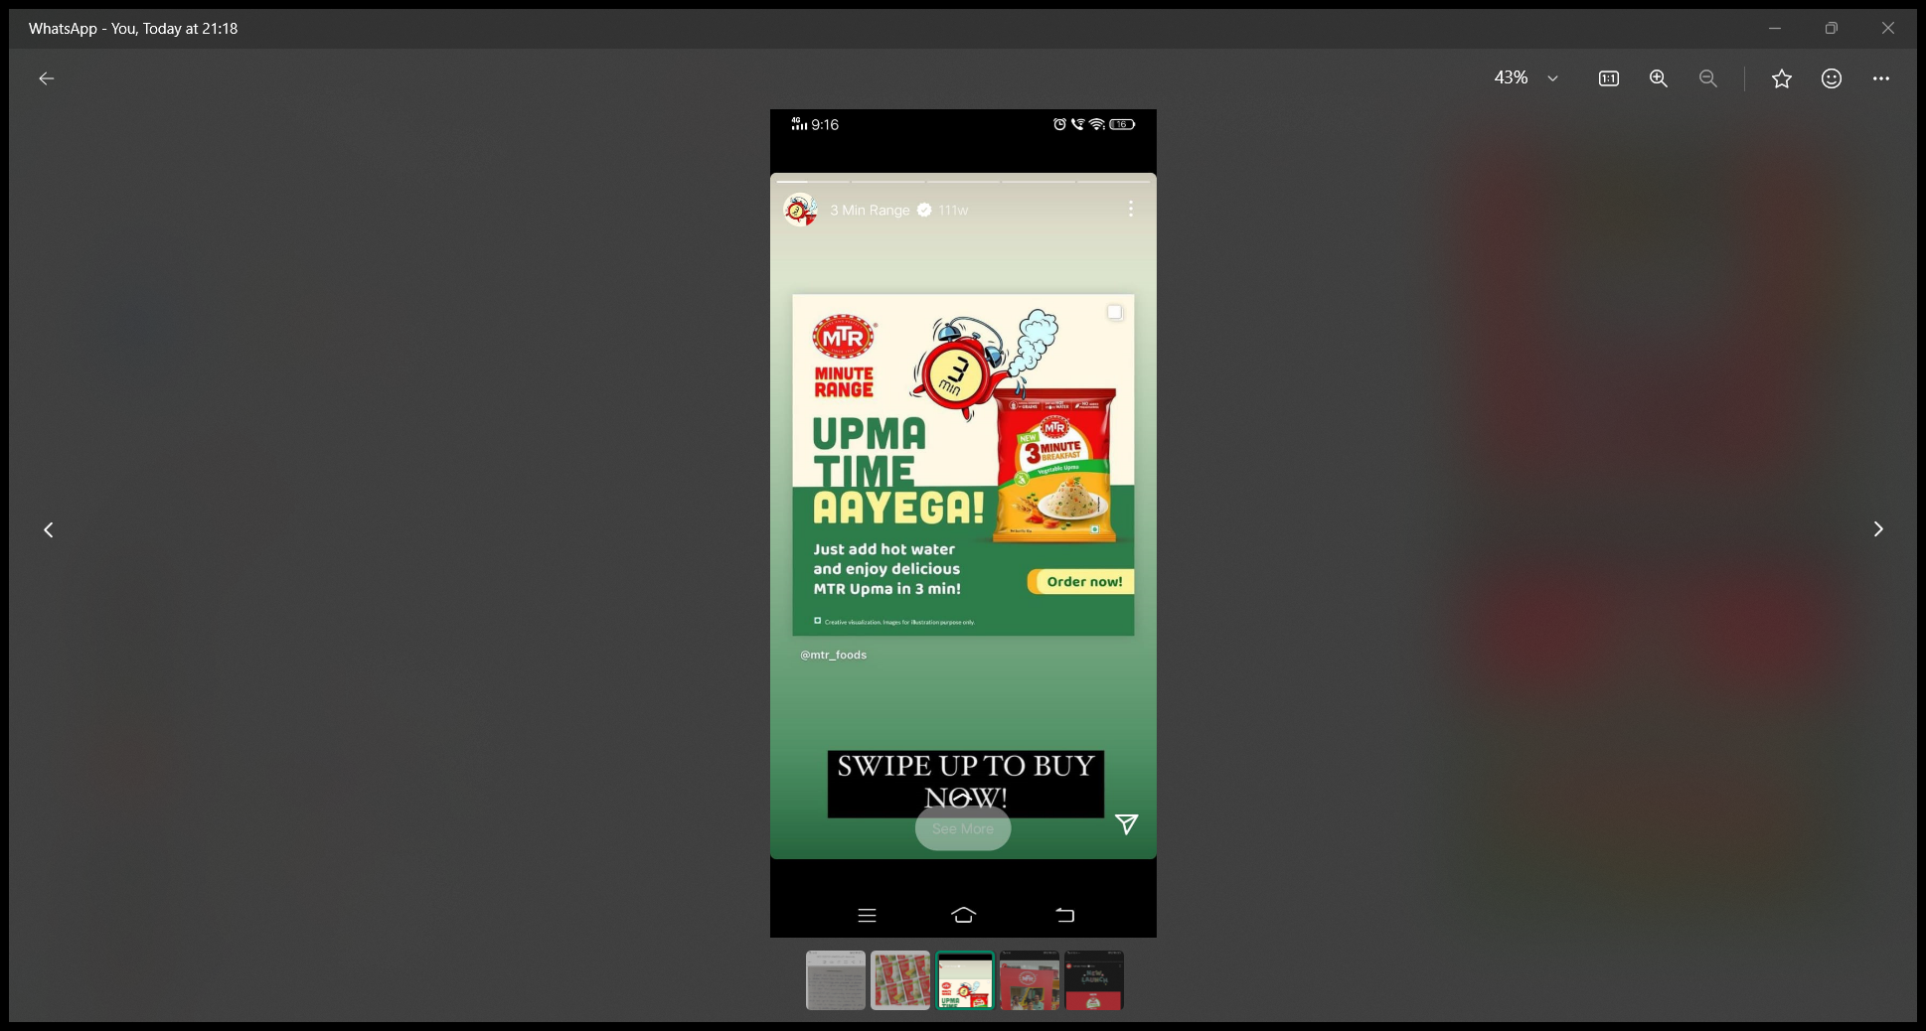
PART 4: CONTENT CREATION AND CURATION (POST CREATIONS, DESIGNS/VIDEO EDITING, AD CAMPAIGNS OVER SOCIAL MEDIA AND EMAIL IDEATION AND CREATION) INSTAGRAM STORY:

Slide 20
PART 4: CONTENT CREATION AND CURATION (POST CREATIONS, DESIGNS/VIDEO EDITING, AD CAMPAIGNS OVER SOCIAL MEDIA AND EMAIL IDEATION AND CREATION)
Designs/Video Editing:
Design tools familiasation (use canva for creating visually appealing graphics )
Video creation utilize VN or any video editor of your choice to create videos related to the chosen topic .
Video link :

Slide 21
PART 4: CONTENT CREATION AND CURATION (POST CREATIONS, DESIGNS/VIDEO EDITING, AD CAMPAIGNS OVER SOCIAL MEDIA AND EMAIL IDEATION AND CREATION)
Social Media Ad Campaign:ns
Ad Campaigns over Social Media:
Come up with 3 ad campaigns each covering one of the mentioned goals: brand awareness, driving website traffic, or generating leads

Slide 22
PART 4: CONTENT CREATION AND CURATION (POST CREATIONS, DESIGNS/VIDEO EDITING, AD CAMPAIGNS OVER SOCIAL MEDIA AND EMAIL IDEATION AND CREATION)
For every campaign clearly define:
Advertising Goals: increasing brand awareness, driving website traffic, or generating leads.
Audience Targeting: Define the target audience for the ad campaigns based on demographics, interests, and behavior.
Ad Creation: Create visually appealing ad creatives, compelling ad copy and relevant call-to-action.

Slide 23
PART 4: CONTENT CREATION AND CURATION (POST CREATIONS, DESIGNS/VIDEO EDITING, AD CAMPAIGNS OVER SOCIAL MEDIA AND EMAIL IDEATION AND CREATION)
Email Ad Campaigns
Ad Campaigns for email marketing:
Come up with 2 email ad campaigns with the mentioned goals: brand awareness & generating leads

Slide 24
Email Ad Campaign 1- Brand Awareness
(insert emailer image)

Slide 25
Email Ad Campaign 2- Lead Generation
(insert emailer image)

Slide 26
PART 4: CONTENT CREATION AND CURATION (POST CREATIONS, DESIGNS/VIDEO EDITING, AD CAMPAIGNS OVER SOCIAL MEDIA AND EMAIL IDEATION AND CREATION)
Reflect on the content creation and curation process, discussing the challenges faced and lessons learned.

